Slide 1
Economy report
The 23th Asia Pacific Legal Metrology Forum
Nov. 23 ~ 25, 2016
Metrology & Measurement Division

Slide 2
CONTENTS
Section 1 – Organization & Structure
Section 2 – Key activities
Section 3 – Future focus

Slide 3
Section 1 – Organization and Structure
Organization and Structure for metrology in Republic of Korea
MSIP
MOTIE
MFDS
(Medical Devices)
KRISS
(Scientific metrology
NMI of Rep. of Korea)
KATS
(Legal metrology)
MoE
(Electric vehicle chargers)
KTC
(Type approval, Verification)
KASTO
(Education, Advertising)
MSIP : Ministry of Science, ICT and Future Planning
MOTIE : Ministry of Trade, Industry and Energy
MFDS : Ministry of Food and Drug Safety
MoE : Ministry of Environment

Slide 4
Section 1 – Organization and Structure
Legislative Frameworks
Measures Act 2015
Enforcement decree / Enforcement rule .2015
12 Measuring instruments
International arrangements and engagement
MoU signed in the filed of Legal Metrology with China (‘16.03)
Annual Korea-Japan cooperation committee for Legal Metrology (‘16.09)
Participation in seminar and forum in China (’16.05, ‘16.08)

Slide 5
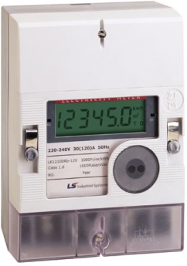
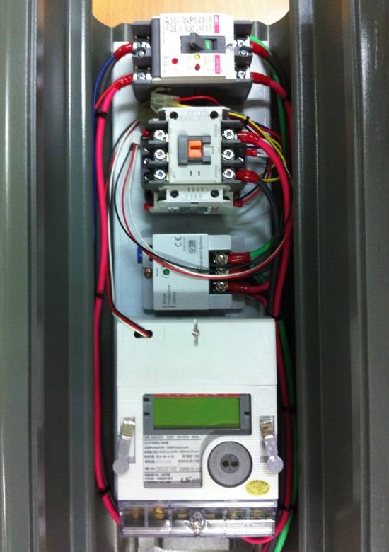
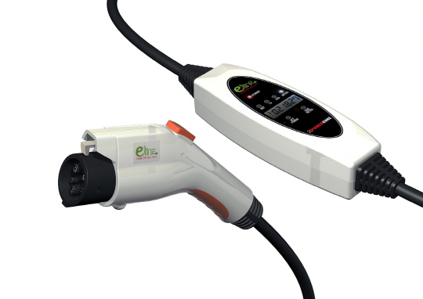
Section 2 – Key activities
Working with industry
EV charger will be one of legal measuring instrument in early 2017
New technical requirements
for type approval & verification
Electricity
meter
Main board
(EV charger)
No problem
Embedded

Slide 6
Section 2 – Key activities
Protecting consumers
Consumer Watchdog(Monitor)
150 Consumer are recruited and training them to check
Re-verification & Regular inspection to NAWI
Using SI units (i.e. : Real estate use tradition units)

Slide 7
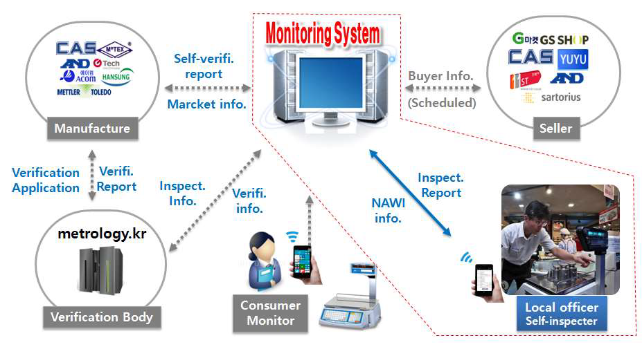
Section 3 – Future focus
Monitoring system of NAWI in use
Increase the reliability, easy to track down the history
Develop IT based monitoring system
IT based (Bar code, QR code, NFC)

Slide 8
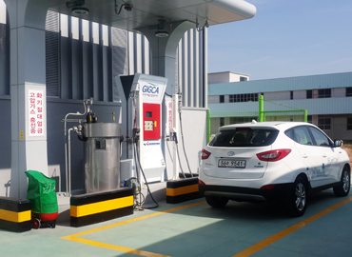
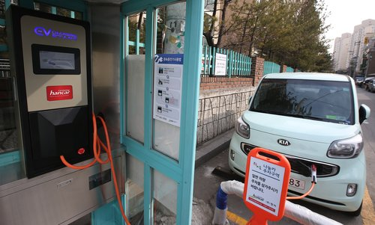
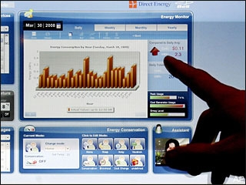
Section 3 – Future focus
Emerging issues – challenges and opportunities
New & Renewable energy industry (EV or Hydrogen Vehicle)
By 2022, smart metering for utility meter will be facilitated

Slide 9
Thanks for interest
ckcho@korea.kr
+82-043-870-5515

