Slide 1





Raising Awareness of Metrology
(MEDEA APMP-APLMF Joint Project 2)
Presented by: Mr Stephen O’Brien
APLMF President
23rd Forum and Working Group meetings
Tokyo Japan
24 November 2016

Slide 2
Raising Awareness of Metrology (MEDEA APMP-APLMF Joint Project 2)
Project Objective
Improve the sharing of information resources between member economies to enable them to increase the awareness of the importance of metrology with consumers, industry, other regulators and government.
Project Team
Joint APMP – APLMF Project team:
APMP: Angela Samuel (others to be confirmed)
APLMF: Stephen O’Brien, Kevin Gudmundsson, Kim Truscott
Looking for 2 additional people from APLMF join the project team

Slide 3
Work package main activities
Develop joint APMP-APLMF metrology web portal
Create a metrology web portal that will introduce and link to useful information on metrology websites including: APMP, APLMF, OIML, BIPM and other authoritative sources:
The overarching design objective is simplicity and ease of use, with multiple layers and links to more technical, complex information in an identified library.
The portal will enable easy access resources that will meet multiple needs for communication and engagement with stakeholders on issues relating to metrology.
Library of resources pulled together.

Slide 4
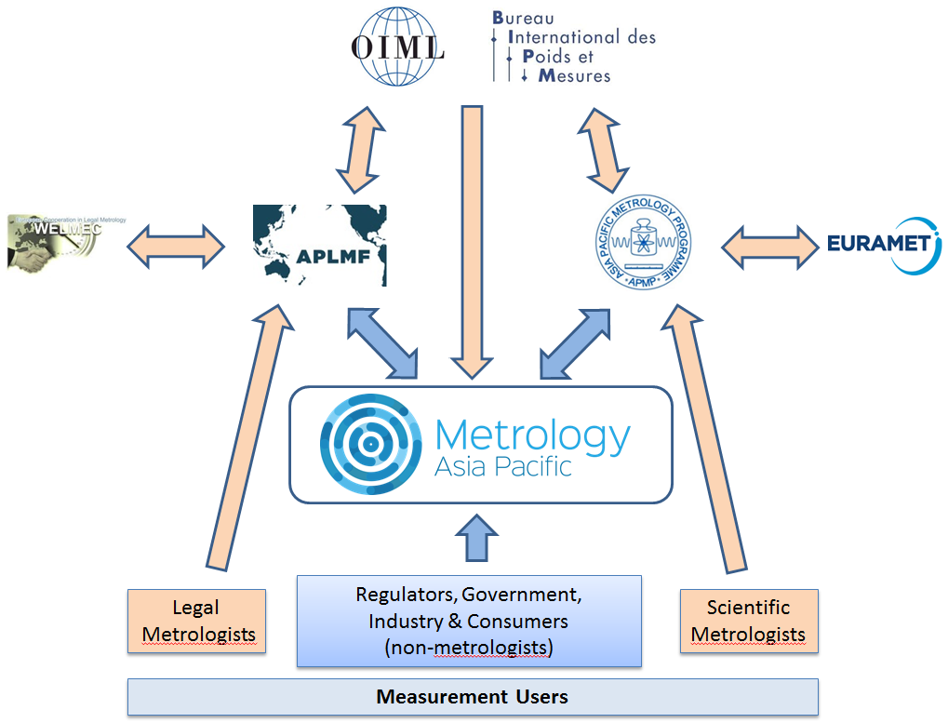
Raising Awareness of Metrology (Web Portal – Metrology Asia Pacific)

Slide 5
Work package main activities
Develop best practice for improving awareness of metrology
Development and use of case studies of successful metrology interventions or information campaigns.
Development, promotion and sharing of resource and collateral materials.
Deliver workshop to share lessons and best practice (planned for mid 2017).

Slide 6
Raising Awareness of Metrology (MEDEA APMP-APLMF Joint Project 2)
Project Goals
Create a relevant and valued web portal – design and deliver a great digital experience where metrology information is centrally curated, easily accessed and well managed.
Curate great content – work with industry partners to collect, curate and provide access to the resources, data and tools that will provide value to the target audiences.
Showcase metrology – present information in a way that clearly presents benefits, methodologies, statistics etc and provides developing economies and the industry with the tools and resources required to show the value of building and improving their metrology infrastructure.
Encourage community contribution and sharing – create a digital resource that the community value and want to participate in. This will ensure the portal remains current, dynamic and valued.

Slide 7
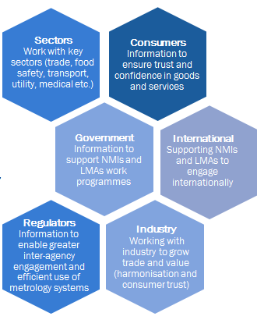
Resources will be of varying level of technicality, as material will need to be used across multiple settings, and by organisations/people who have varying understanding of metrology issues. Including:
Material to support public information campaigns to build consumer confidence in products and services, particularly in measuring safety in food, safety of products, trust in the price being charged for metered services
Information to build understanding of industry stakeholders on the importance of metrology infrastructure and standards and enforcement activities, in terms of growing trade, ensuring safety and increasing the value of their business
Information for government agencies and other regulators, particularly information relating to costs and benefits/value for money, to support the activities and infrastructure needs of National Measurement Institutes (NMIs) and Legal Metrology Authorities (LMAs)

Slide 8
Project Progress To Date
July - September 2016: Engaged web-design company to develop ‘mock up’ of web portal design in consultation with project team. This included:
  Identifying the intended audience and their journeys through the site
  Creating a customer experience framework
  Developed a high level Information Architecture (content plan)
  Created visual design guidelines
  Created website wireframes
  Created detailed visual designs
  Developed and tested the new web portal

Slide 9
Project Progress To Date
August 2016 – March 2017: Collect and assess case studies and develop a methodology which can be used to identify key success factors. Develop resources for the portal to provide accessible information on the economic and social impact of metrology. This included:
  Using content from the APLMF / APMP and other international metrology websites and guidance materials
  Utilised the ‘National Metrological Infrastructure For Developing Economies: Guide 1’ for information
  Contracted a writer to begin creating content for the ‘About metrology’ and ‘Sectors’ areas of the web portal

Slide 10

Next Steps – 2016/17
November 2016: APLMF/APMP meeting - working session to discuss the proposed approach for the project, test the design and proposed material for the portal with member economies, test proposed methodology of cases studies
April 2017: Web portal goes live:
Mid 2017: Workshop - build members’ understanding of different approaches, tools and techniques for raising awareness, with invited guests who have undertaken programmes and using case study methodology to build skills of participants

Slide 11
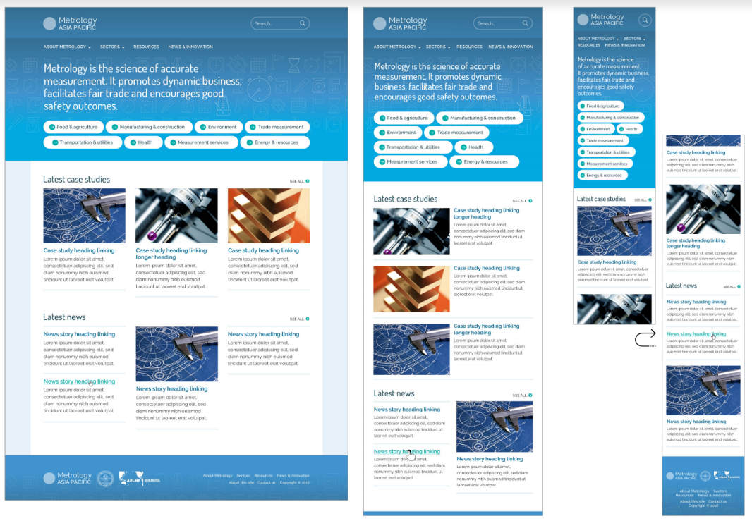

Slide 12
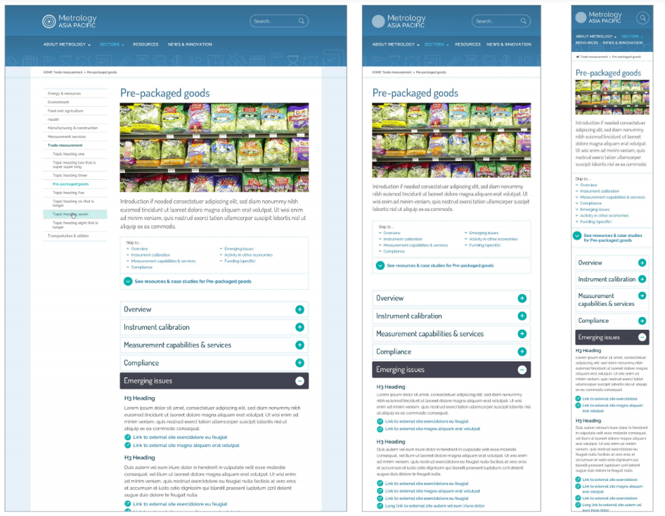

Scale to be viewed on any device:

Slide 13
Content has yet to be fully developed but the structure is in place and you are able to see how it is intended to operate
Site is still under development but can be viewed at:
  www.metrologyasiapacific.com
Currently it is still password protected so you need to following details to access it:
  Username: info@aplmf.org
  Password: Aplmf2016!
Other URLS that will also link to the site:
  metrologyasiapacific.org
  measurementasiapacific.com
  measurementasiapacific.org
Interested in APLMF member comments and feedback at any stage. Send comments to: secretariat@aplmf.org

Slide 14


Thank you for your time and attention.
Mr Stephen O’Brien: president@aplmf.org

