Slide 1
APLMF Guides and Online Modules
Kevin Gudmundsson
Legal Metrology Advisor
Trading Standards
MBIE
New Zealand
Notes:
Good morning, I would just like to provide an overview of the findings following analysis of your survey results and how these will be developed into guides and potentially online modules.

Slide 2
Survey results
Analysis of survey results for each training course to develop benchmark test procedures for the following topics
Average Quantity System
CNG dispensers
Fuel dispensers
Rice moisture meters
Taxi meters
Notes:
Surveys were circulated to all members that included proposed benchmark test procedures for each of the MEDEA training courses that have taken place thus far.
I would like to quickly provide you with an overview of those results

Slide 3
Average Quantity System Inspection
Test Name | Total economies surveyed | Adopted | Not implemented | Economies not responded
1.Define the inspection lot | 19 | 14 | 1 | 4
2. Determining the appropriate sample size | 19 | 13 | 2 | 4
3. Determine the appropriate T1 and T2 values | 19 | 14 | 1 | 4
4. Determine the number of prepackages allowed to exceed the tolerable deficiency | 19 | 13 | 2 | 4
5. Determine the average tare weight | 19 | 14 | 1 | 4
6. Determine the individual prepackage error | 19 | 15 | 0 | 4
7. Determine if the test results meet the individual prepackage requirements | 19 | 14 | 1 | 4
8. Determine if the test results meet the average prepackage requirement | 19 | 14 | 1 | 4
Economies responded
Australia, Canada, Cambodia, DPR of Korea, Hong Kong China, Indonesia, Japan, Malaysia, Mongolia, New Zealand, Papua New Guinea, Singapore, Chinese Taipei, Thailand, Vietnam
Notes:
We received response from 15 out of the 19 surveys circulated for the Average Quantity System inspections. As you can see the majority of members were in favour of adopting these proposed test procedures.

Slide 4
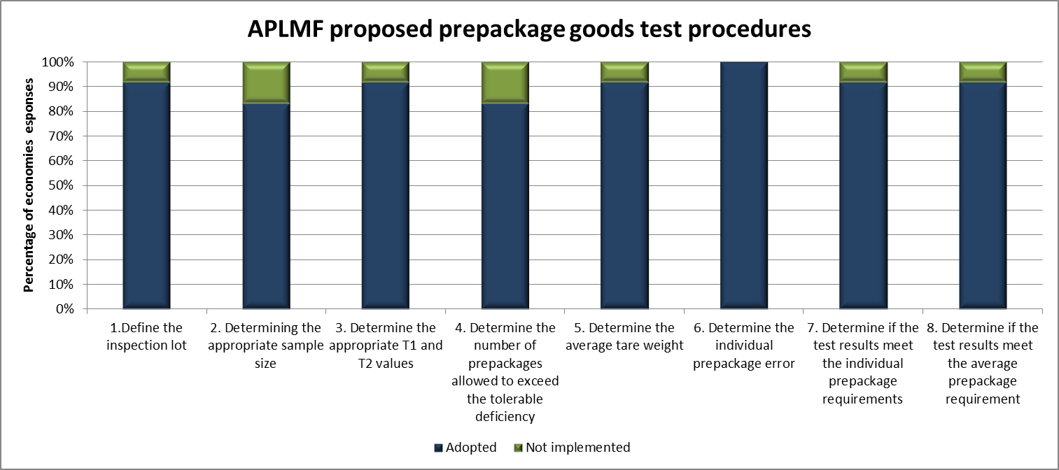
Average Quantity System Inspection
Notes:
This can be clearly seen in the bar graph for each of the 8 tests.

Slide 5
CNG dispensers
Economies responded
Australia, Canada, Cambodia, DPR of Korea, Hong Kong China, Indonesia, Japan, Malaysia, Mongolia, New Zealand, Singapore, Chinese Taipei, Thailand, Vietnam
Test Name | Total economies surveyed | Adopted | Not implemented | Economies not responded
1. Verification of CNG Dispensers | 19 | 13 | 1 | 5
2. Test Method | 19 | 13 | 1 | 5
3.General safety requirements | 19 | 14 | 0 | 5
4. Required equipment | 19 | 13 | 1 | 5
5. Visual Inspection | 19 | 14 | 0 | 5
6. Performance test procedure | 19 | 12 | 2 | 5
Notes:
We received response from 14 out of the 19 surveys circulated on how to test CNG dispensers. Again the majority were in favour of adopting these proposed test procedures.

Slide 6
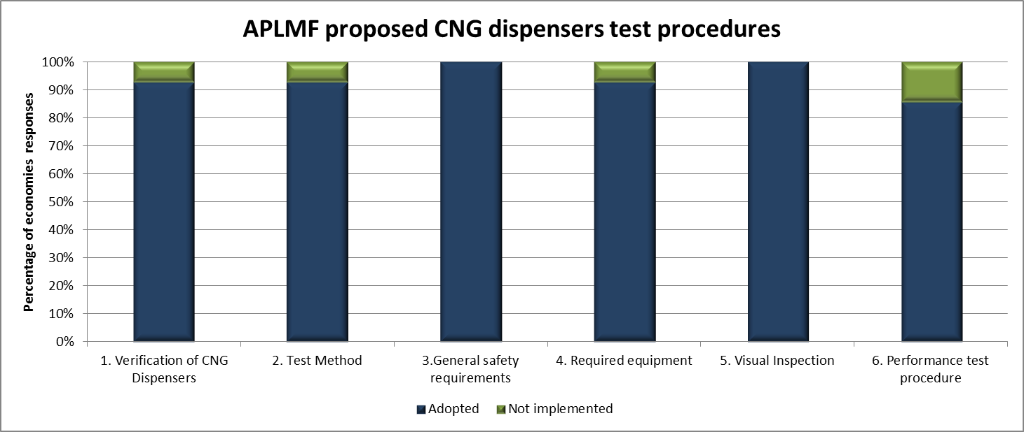
CNG dispensers
Notes:
This is easier seen here

Slide 7
Fuel dispensers
Test Name | Total economies surveyed | Adopted | Not implemented | Economies not responded
1. Visual inspection | 19 | 14 | 1 | 4
2. Checking facility for electronic indicators | 19 | 15 | 0 | 4
3. Pero setting | 19 | 14 | 1 | 4
4. Price computing | 19 | 14 | 1 | 4
5. Nozzle cut-off | 19 | 13 | 2 | 4
6. Interlock | 19 | 15 | 0 | 4
7. Pre-set indications | 19 | 13 | 2 | 4
8. Maximum flow rate | 19 | 13 | 2 | 4
9. Accuracy | 19 | 13 | 2 | 4
10. Accuracy of pre-set | 19 | 12 | 3 | 4
11. Gas elimination | 19 | 12 | 3 | 4
12. Anti-drain / Hose dilation | 19 | 12 | 3 | 4
Economies responded
Australia, Cambodia, Canada, DPR of Korea, Hong Kong China, Indonesia, Japan, Malaysia, Mongolia, New Zealand, Papua New Guinea, Singapore, Chinese Taipei, Thailand, Vietnam
Notes:
15 out of the 19 surveys circulated for the proposed 12 tests for conducting the verification of fuel dispenser was received. Although the tests for determining the accuracy of the pre-set, gas elimination and Anti drain and hose dilation tests received the highest returns for them not to be implemented, the majority of responses received did support there inclusion.

Slide 8
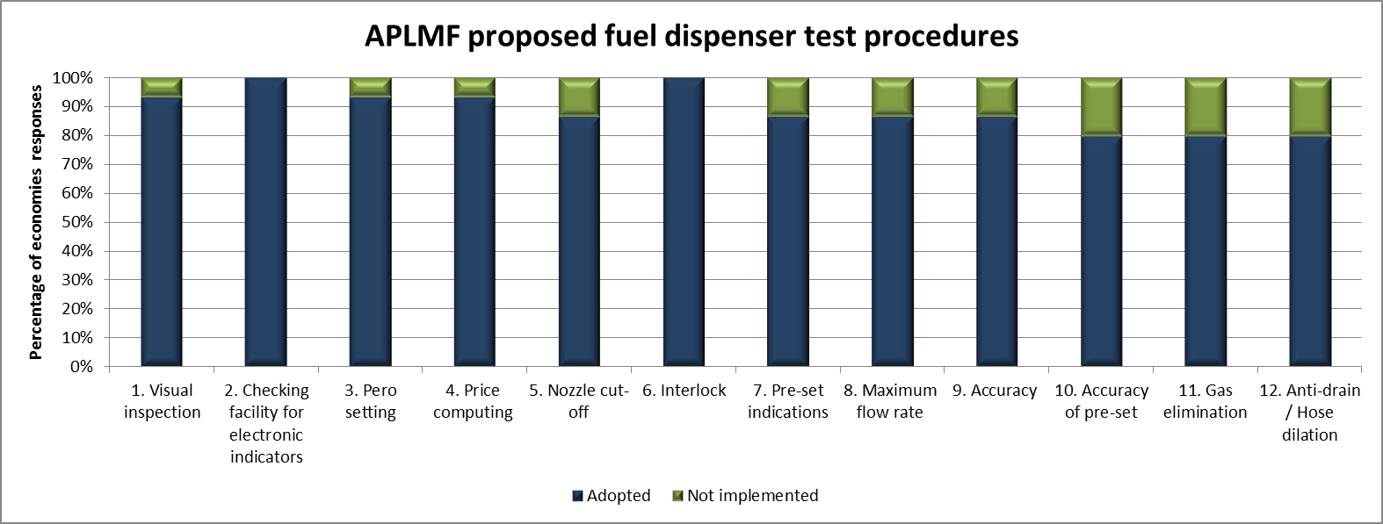
Fuel dispensers

Slide 9
Rice moisture meters
Economies responded
Cambodia, Canada, Hong Kong China, Indonesia, Japan, Malaysia, Mongolia, New Zealand, Papua New Guinea, Chinese Taipei, Thailand, Vietnam
Test Name | Total economies surveyed | Adopted | Not implemented | Economies not responded
1. Environmental condition | 19 | 11 | 1 | 7
2. Reference samples | 19 | 12 | 0 | 7
3. Visual and electrical inspections | 19 | 12 | 0 | 7
4. Measurement of errors | 19 | 11 | 1 | 7
Notes:
12 responses were received for proposed test procedures for testing rice moisture meters, the majority of you all being in favour of adopting.

Slide 10
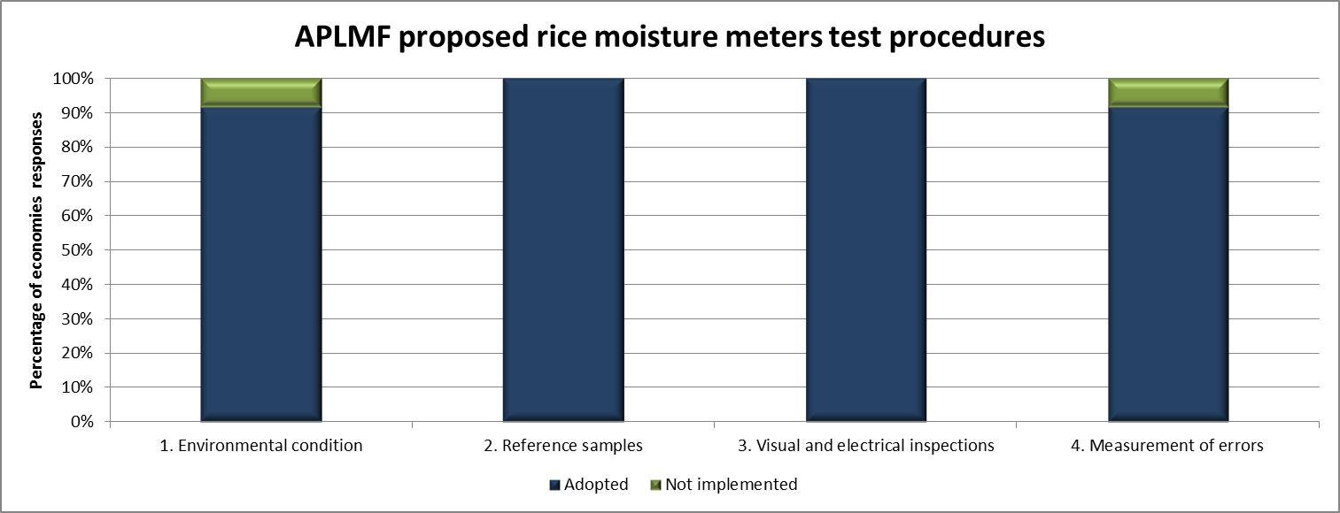
Rice moisture meters

Slide 11
Taxi meters
Economies responded
Cambodia, Canada, Hong Kong China, Indonesia, Japan, Malaysia, Mongolia, New Zealand, Papua New Guinea, Chinese Taipei, Thailand, Vietnam
Test Name | Total economies surveyed | Adopted | Not implemented | Economies not responded
1. Distance measurement transducer | 19 | 10 | 2 | 7
2. Display screen | 19 | 12 | 0 | 7
3.Tires of driving wheels | 19 | 11 | 1 | 7
4. Load | 19 | 10 | 2 | 7
5. Calculate the tire correction value | 19 | 11 | 1 | 7
6. Calculate the using error | 19 | 10 | 2 | 7
Notes:
Finnaly for the 12 surveys received for the proposed tests procedures for testing a taxi meter, again an outright majority vote for adoption.

Slide 12
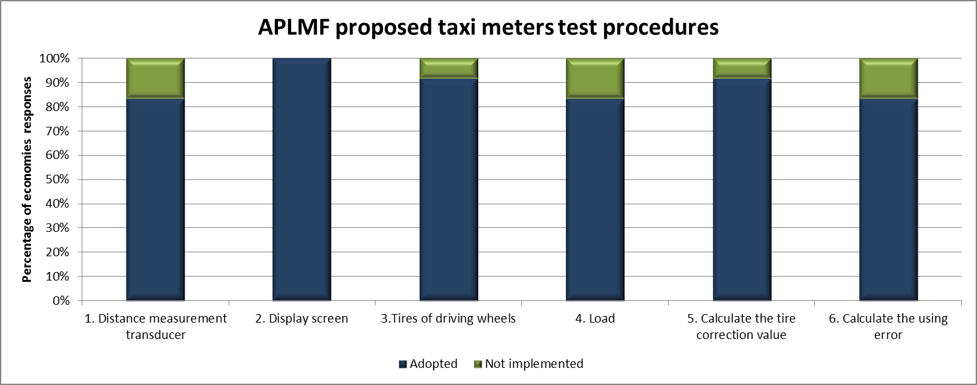
Taxi meters

Slide 13

Topic Guides
A Guide will be developed for each topic
The Fuel dispensers has been developed as an example ‘Guide 4’
Each guide will be circulated to all members for final review and comments
The guides will then be made available on the APLMF website
Notes:
So what this working group now intends to do with each topic is to develop them into guides.
Marian and I have already drafted the ‘Verification of fuel dispensers’ topic into a potential guide.
As you can see from this guide which has been uploaded to the APLMF meeting documents page, we have provided an introduction explaining the origins, the test procedures, Summary of Economy Reports presented and completed at the training course, Survey results on adopting the test procedures, which I have just shown you and all survey responses themselves attached in an appendix.
Each guide will be circulated once again to all member economies for final review and comment. Then once agreed they will be made available on the APLMF website.

Slide 14
e-learning modules
Topics will be selected to be converted into online training modules.
The intent is for each module to include:
A detailed explanation of each test and how it is performed
  (multiple languages where possible)
Video learning using animated infographics
User interactive capability
Exercises on calculations
Staged self-assessment tests
Final assessment
Automatic reporting to candidates and managers
Notes:
View modules –
https://play.wl.co.nz/login/index.php
Username: aplmf
Password: micd9Cain
A proposal was presented to PTB to select one of the topics and develop it into an online module.
It was proposed that each module would include
A detailed explanation of each test and how it is performed (ideally in multiple languages)
Video learning using animated infographics
User interactive capability
Exercises on calculations
Staged self-assessment tests
Final assessment
Automatic reporting to candidates and managers

Slide 15
e-learning modules
Developing the first module-
First module developed as a trial
  Establish costs (time / resources / developers needs / user expectations and suitability / Asia Pacific access requirements)
Funding – PTB (national metrology institute, Germany) and Trading Standards (Legal Metrology unit, New Zealand)
Members economies maybe requested to assist in user testing
Notes:
This initial trial would allow us to establish costs associated with the development and understand what the user expectations and needs are, along with finding a suitable site to host them on which is accessible to all.
The first online module will be funded by PTB and New Zealand and we may contact members to assist in user testing.

Slide 16

e-learning modules - example
Notes:
I have made initial contact with a New Zealand based e-learning developer that has extensive experience in producing technical based online modules. They have shared this module which was developed for technicians who work with a dangerous gas known as SF6.
They have a number of features which I think would be suitable for educating our legal metrology officers in how to perform testing of measuring instruments.

Slide 17
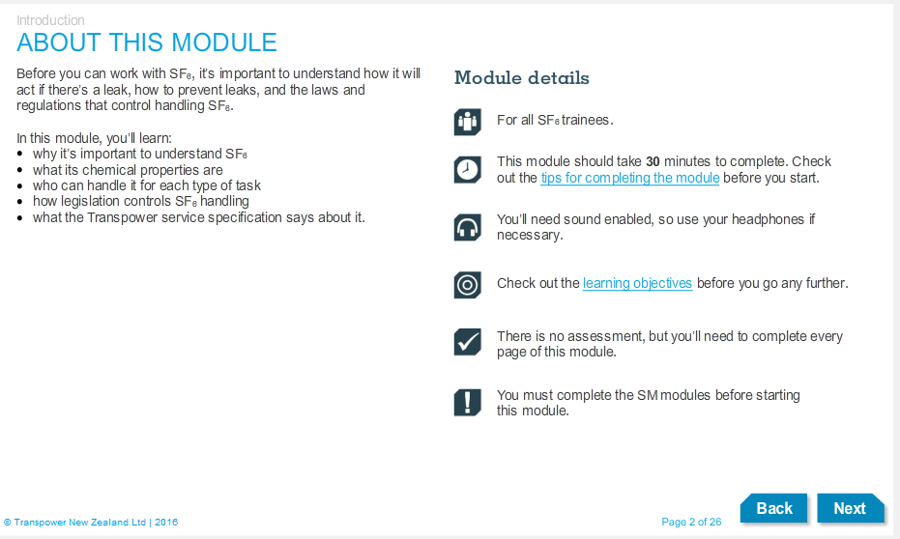
e-learning modules - example

Slide 18
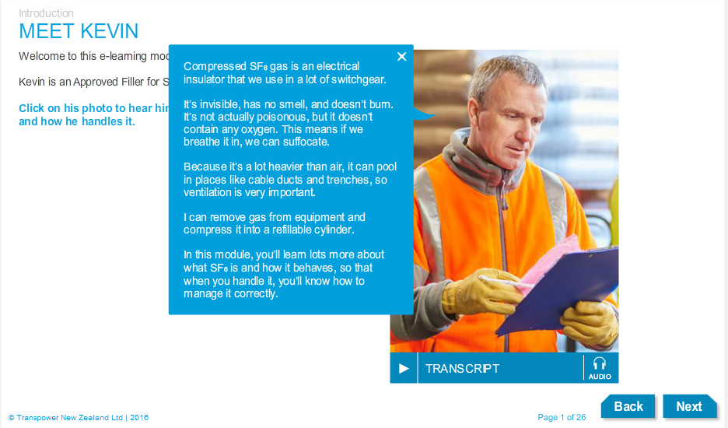
e-learning modules - example

Slide 19
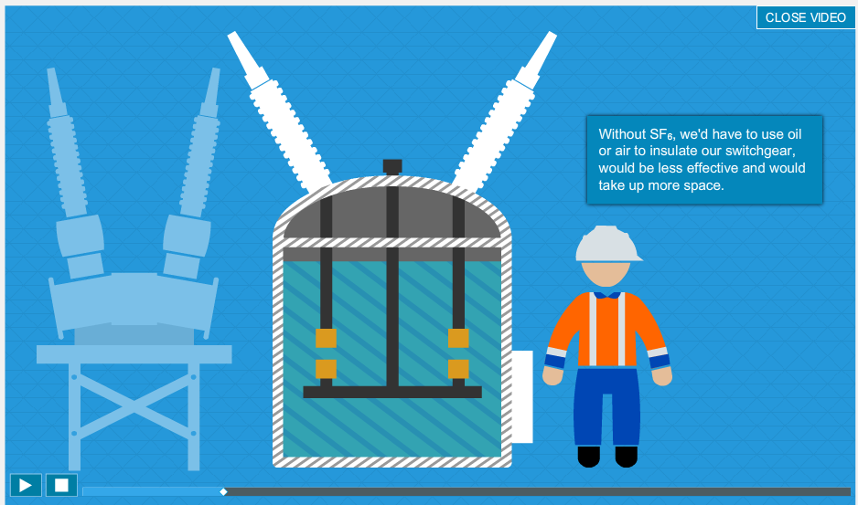
e-learning modules - example

Slide 20
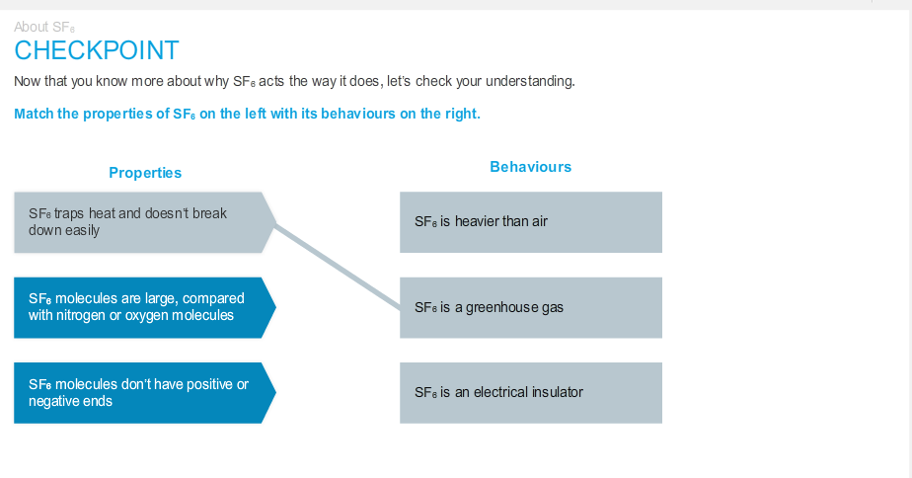
e-learning modules - example

Slide 21
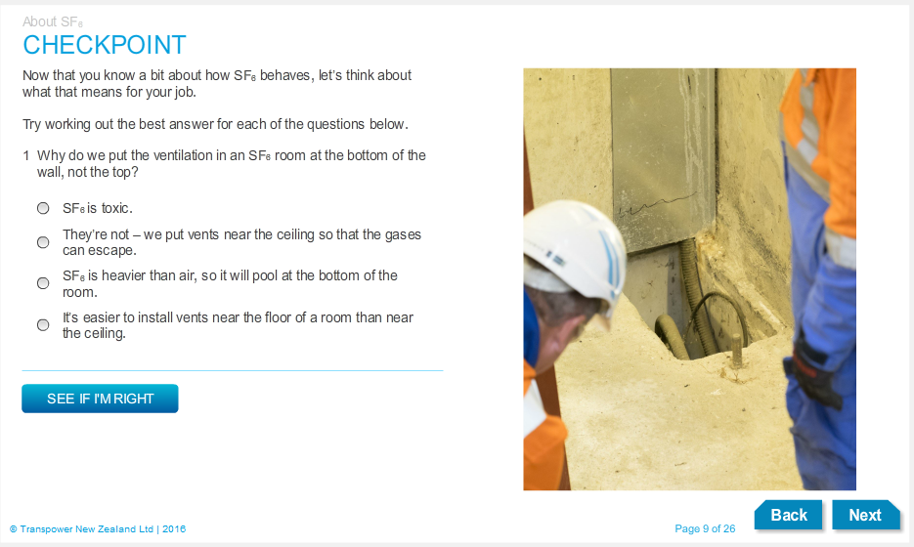
e-learning modules - example

Slide 22
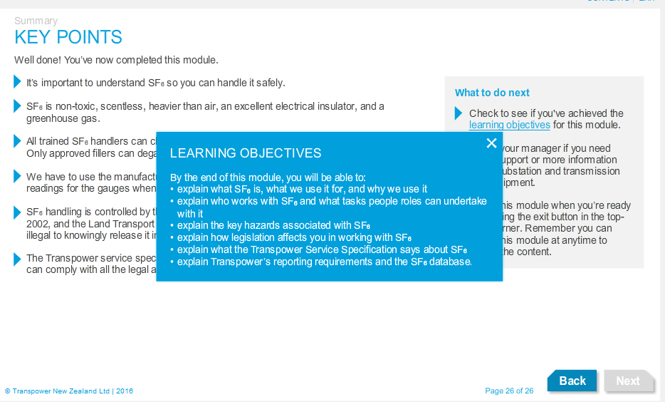
e-learning modules - example

Slide 23
Action Points
The action points for 2017 are:
Develop all topics into Guides and circulate to all APLMF members for final review and comment
Upload completed Guides to the APLMF website
Develop trial online training module and establish suitability and demand
Notes:
The action points for 2017 are:
Develop all topics into Guides and circulate to all APLMF members for final review and comment
Upload completed Guides to the APLMF website
Develop trial online training module and establish suitability and demand

Slide 24
Thank You For Your Attention
Any Questions
Kevin Gudmundsson
Legal Metrology Advisor
Trading Standards
MBIE
New Zealand

