Slide 1
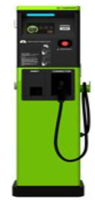
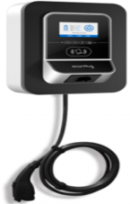
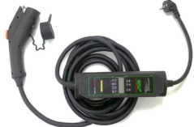
Republic of Korea - Economy Report Highlights
Key Activities – 2018/19
New Addition to Legal Measuring Instrument
Smart Meter
May 2019, Electric Vehicle Charger became legally controlled measuring instrument and DC electricity meter was added as an additional type of electricity meter subject to type approval
Measures Act Enforcement Decree was amended
Type approval and verification requirement will come into force in January, 2020
The focus of Korean Measures Act has been on the manual reading and error management to manage legal measuring instruments
Environment for the utility meters are rapidly changing, this immediate response is required
Comprehensive countermeasures have been prepared:
1. Create sustainable ecosystem
2. Vitalize supply of smart meter
3. Vitalize demand of smart meter
4. Construct standard, test, and certification system
In order to support the countermeasures, Korea Smart Metering Forum has been working towards establishing group standards and amendment of technical regulations
Future Focus - 2020 & beyond
Management System for Weighing Instrument under 10 tons
Improvement of MIMS
Under the Measures Act, non-automatic weighing instruments under 10 tons are subject to regular 2 year periodic inspection
Challenge:
Local government offers’ lack of expertise
Difficult to locate whereabouts of all NAWIs
Expansion of self-management by the private sector is under review to replace the regular inspection by the local government officers.
Discussions with the stakeholders will be held in the near future.
KATS launched the Metrology Information Management System (MIMS) in 2013
The major functions of MIMS are:
Management of legal measuring instrument
Management of imported measuring instrument
Notification of schedule
The current issue with MIMS is lack of expandability and interoperability
To resolve the issue, improvement of the system with the latest ICT technology is under review
Once MIMS is advanced with the latest ICT, more efficient management and wide usage of metrology information are anticipated
[Legal Metrology Authority Logo]
Presenter – Ji Yeon Kim

